Slide 1
ethical data science capstone
DS 496 – Final Presentation 2023
Variability of Plasma Retinol Concentration Based on Personal Health
Daniel Hufnagle

Slide 2
Project description
Motivation and Background:
Observational studies have suggested that low dietary intake or low plasma concentrations of retinol might be associated with increased risk of developing certain types of cancer. However, relatively few studies have investigated the determinants of plasma concentrations of these micronutrients.
Retinol deficiency can lead to a range of health problems, including night blindness and increased susceptibility to infections.
The data can be used to develop and test statistical models that can predict plasma retinol levels based on other variables, such as age, sex, and various dietary intakes.
Research Questions:
What correlations/relationships can be found between Retinol Plasma levels and variables within this data set?
Are there any unusual trends/relationships with these variables?

Slide 3
Data and challenges
Structured Numerical/Categorical
Determinants of Plasma Retinol and Beta-Carotene Levels
http://lib.stat.cmu.edu/datasets/Plasma_Retinol
315 observations on 14 variables
Data Preparation:
Formatting issues when importing data set
No missing values

Slide 4
Modeling & analysis
Exploratory Data Analysis:
Multiple Regression
Exploratory Factor Analysis
Linear Discriminant Analysis
Analysis/Modeling Tasks:
Pearson Correlation
Variable Importance
Density Analysis

Slide 5
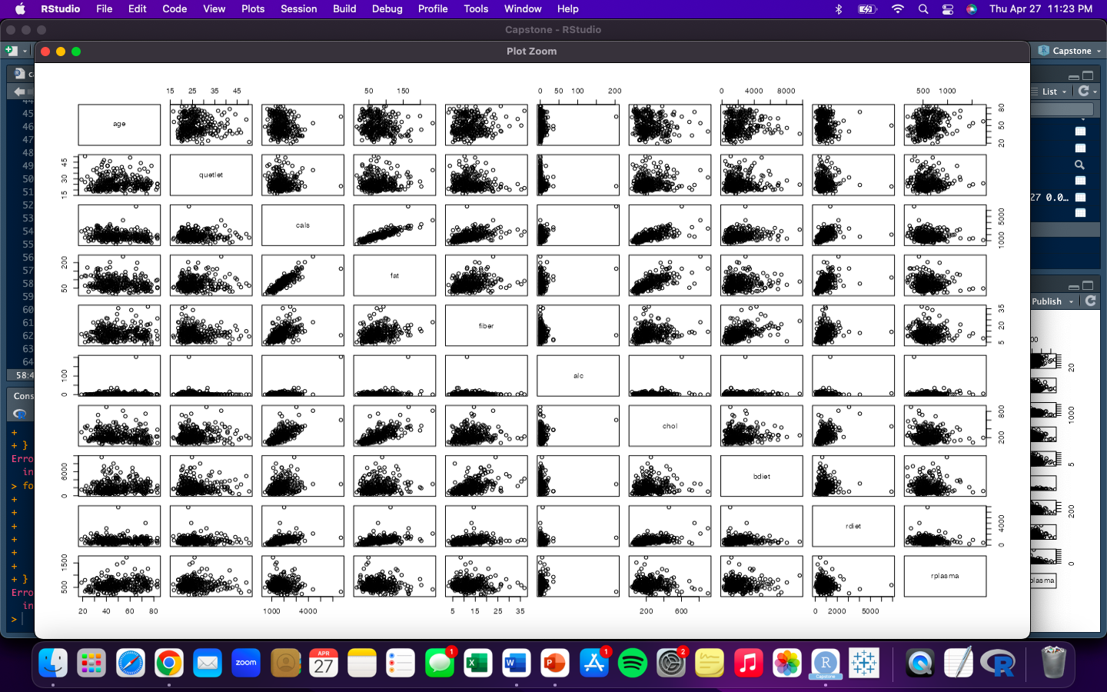
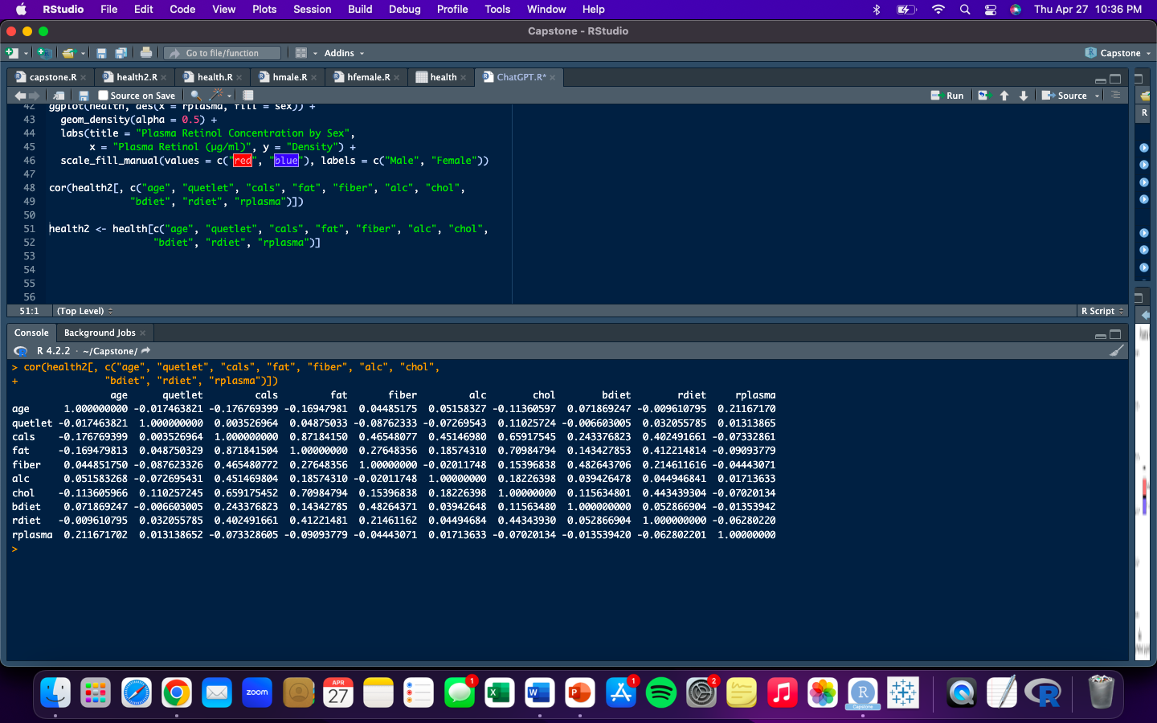
Modeling & analysis

Slide 6
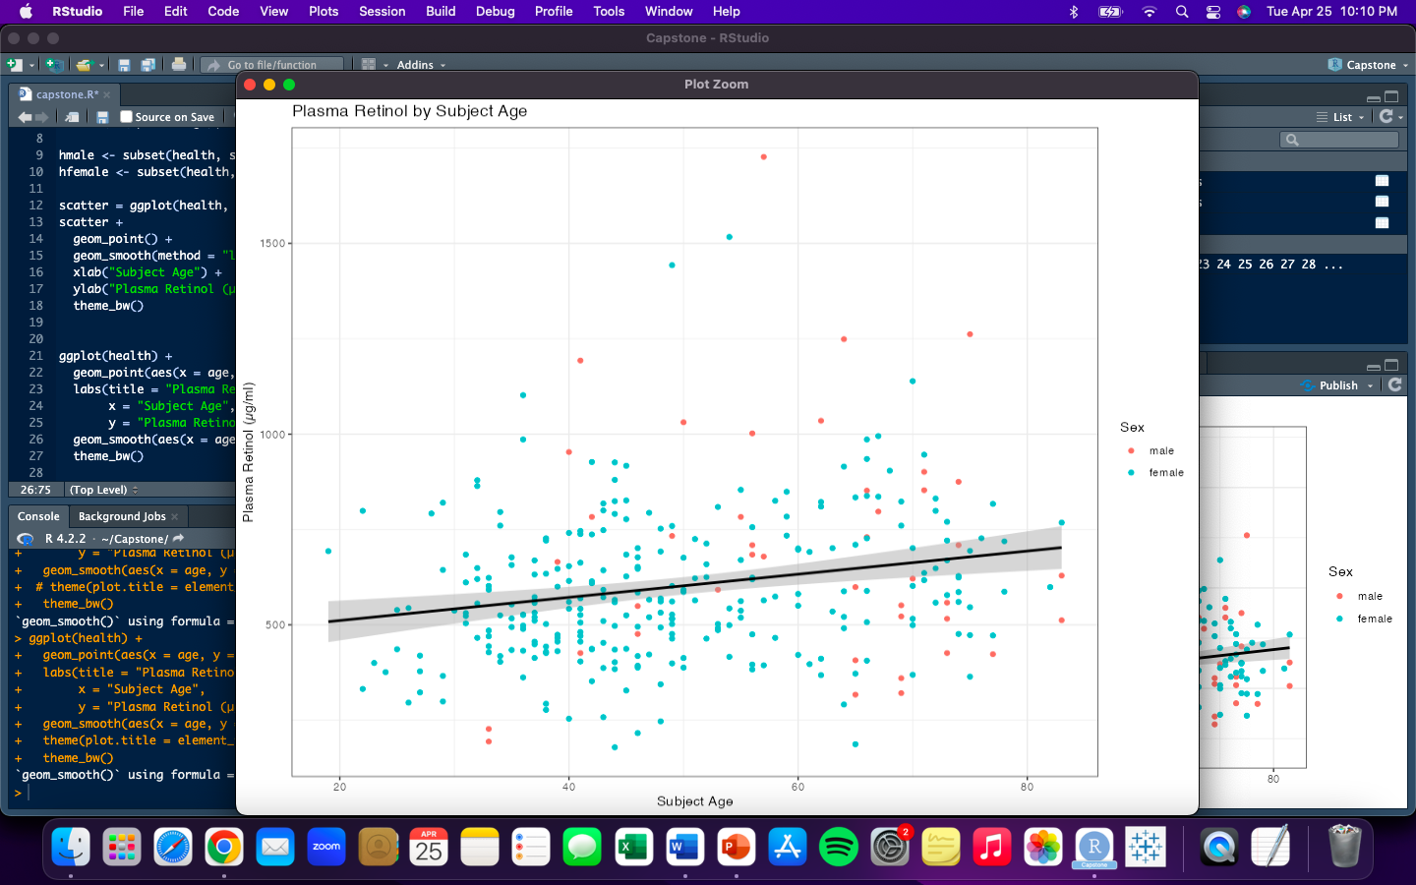
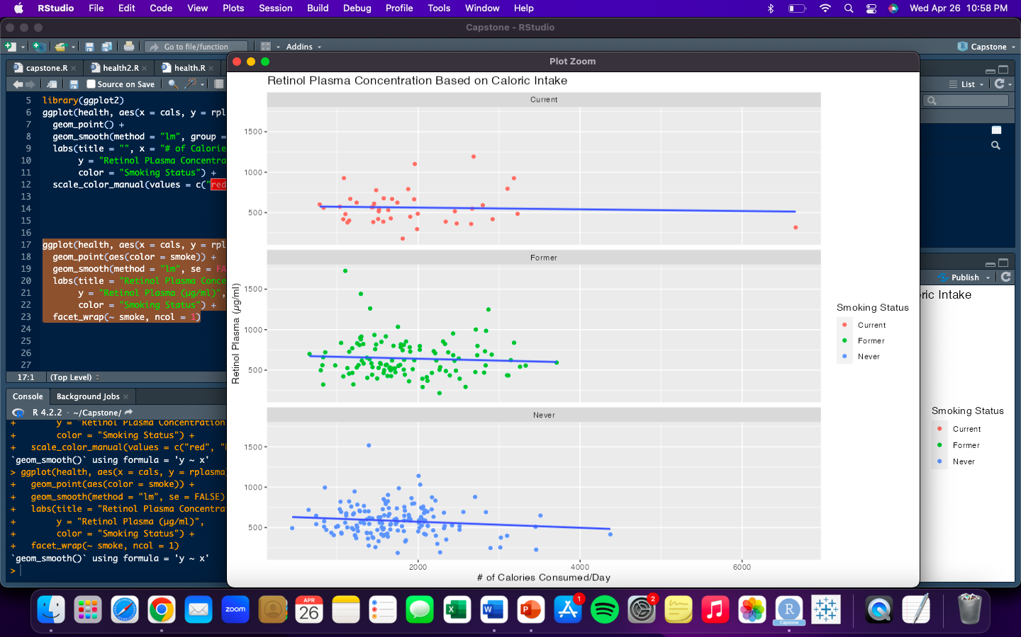
Modeling & analysis

Slide 7
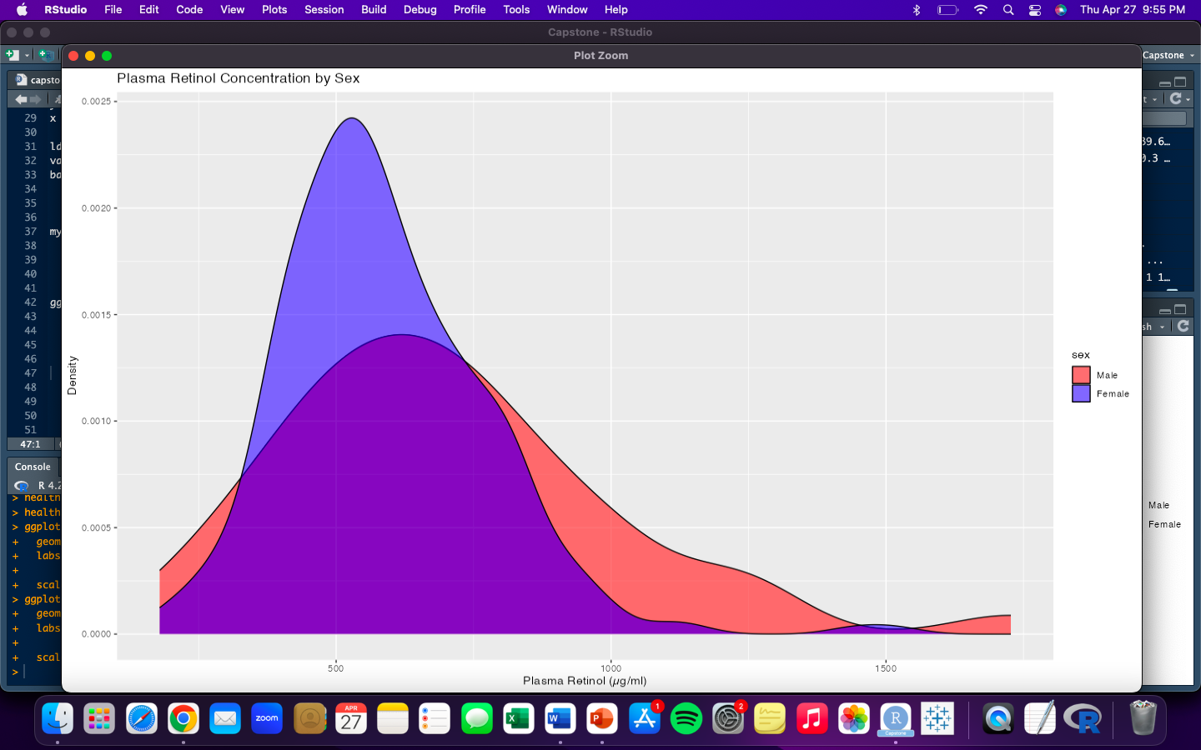
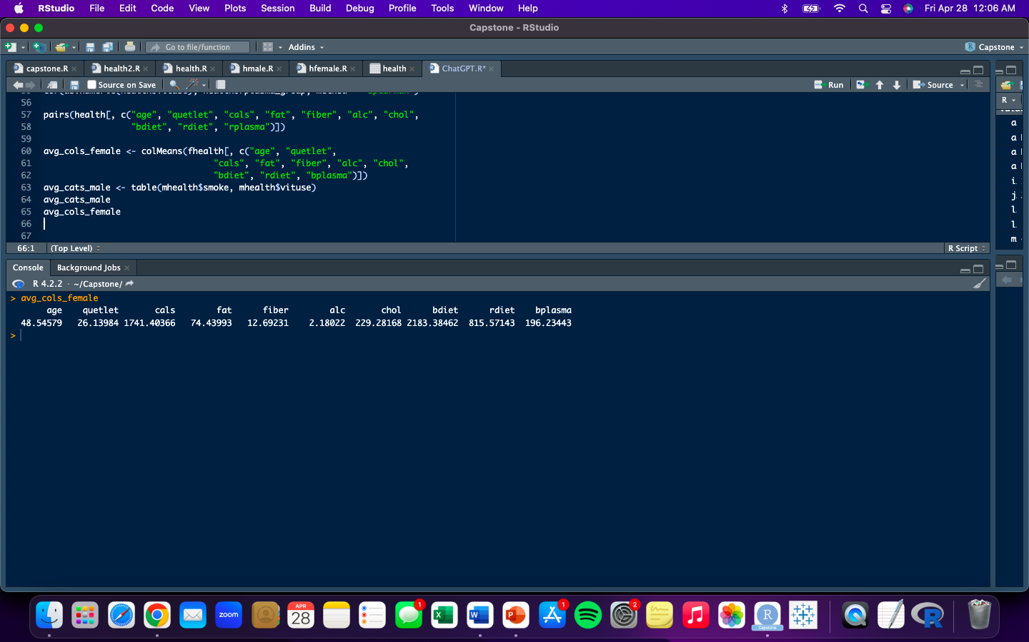
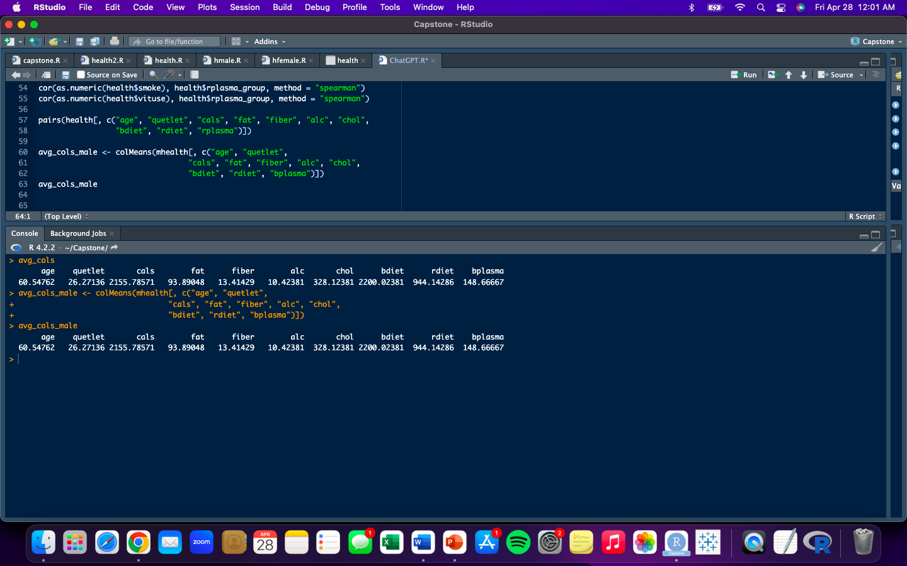
Modeling & analysis
Women have a 52% probability of never smoking and a 39% probability of regularly taking vitamins
Men have a 52% probability of being a former smoker and a 54% probability of not taking vitamins regularly

Slide 8
Insights & results
Wide variability of Retinol Plasma concentration in humans
No significant correlations between any recorded variables in this examination
The sampled males had a noticeable variance in their Plasma Retinol concentration
A better understanding of this subject would require further study

